Slide 1

Algorithms and Data Structures 2 CS 1501
Fall 2021
Sherif Khattab
ksm73@pitt.edu
(Slides are adapted from Dr. Ramirez’s and Dr. Farnan’s CS1501 slides.)

Slide 2
Announcements
Upcoming deadlines:
4/19: Assignment 4
4/21: Homework 12
4/23: Lab 11
4/30: Lab 12
5/2: Assignment 5
5/2: Bonus Homework
Tophat questions are due one week after each lecture
OMETs
1 bonus point for entire class when response rate >= 80%
Currently at ~33%
Deadline is Sunday 4/25

Slide 3
Last lecture …
(Big)Integer Algorithms
exponentiation
GCD
Encryption

Slide 4
So what's the runtime???
Recursion really complicates our analysis…
We’ll use a recurrence relation to analyze the recursive runtime
Goal is to determine:
How much work is done in the current recursive call?
How much work is passed on to future recursive calls?
All in terms of input size

Slide 5
Recurrence relation for divide and conquer multiplication
Assuming we cut integers exactly in half at each call
I.e., input bit lengths are a power of 2
Work in the current call:
Shifts and additions are Θ(n)
Work left to future calls:
4 more multiplications on half of the input size
T(n) = 4T(n/2) + Θ(n)

Slide 6
Soooo… what’s the runtime?
Need to solve the recurrence relation
Remove the recursive component and express it purely in terms of n
A “cookbook” approach to solving recurrence relations:
The master theorem

Slide 7
The master theorem
Usable on recurrence relations of the following form:
T(n) = aT(n/b) + f(n)
Where:
a is a constant >= 1
b is a constant > 1
and f(n) is an asymptotically positive function
Notes:
Note this does NOT cover nearly all possible recurrence relations, just really handy for alot of them
We will need more different techniques for more problematic recurrences

Slide 8
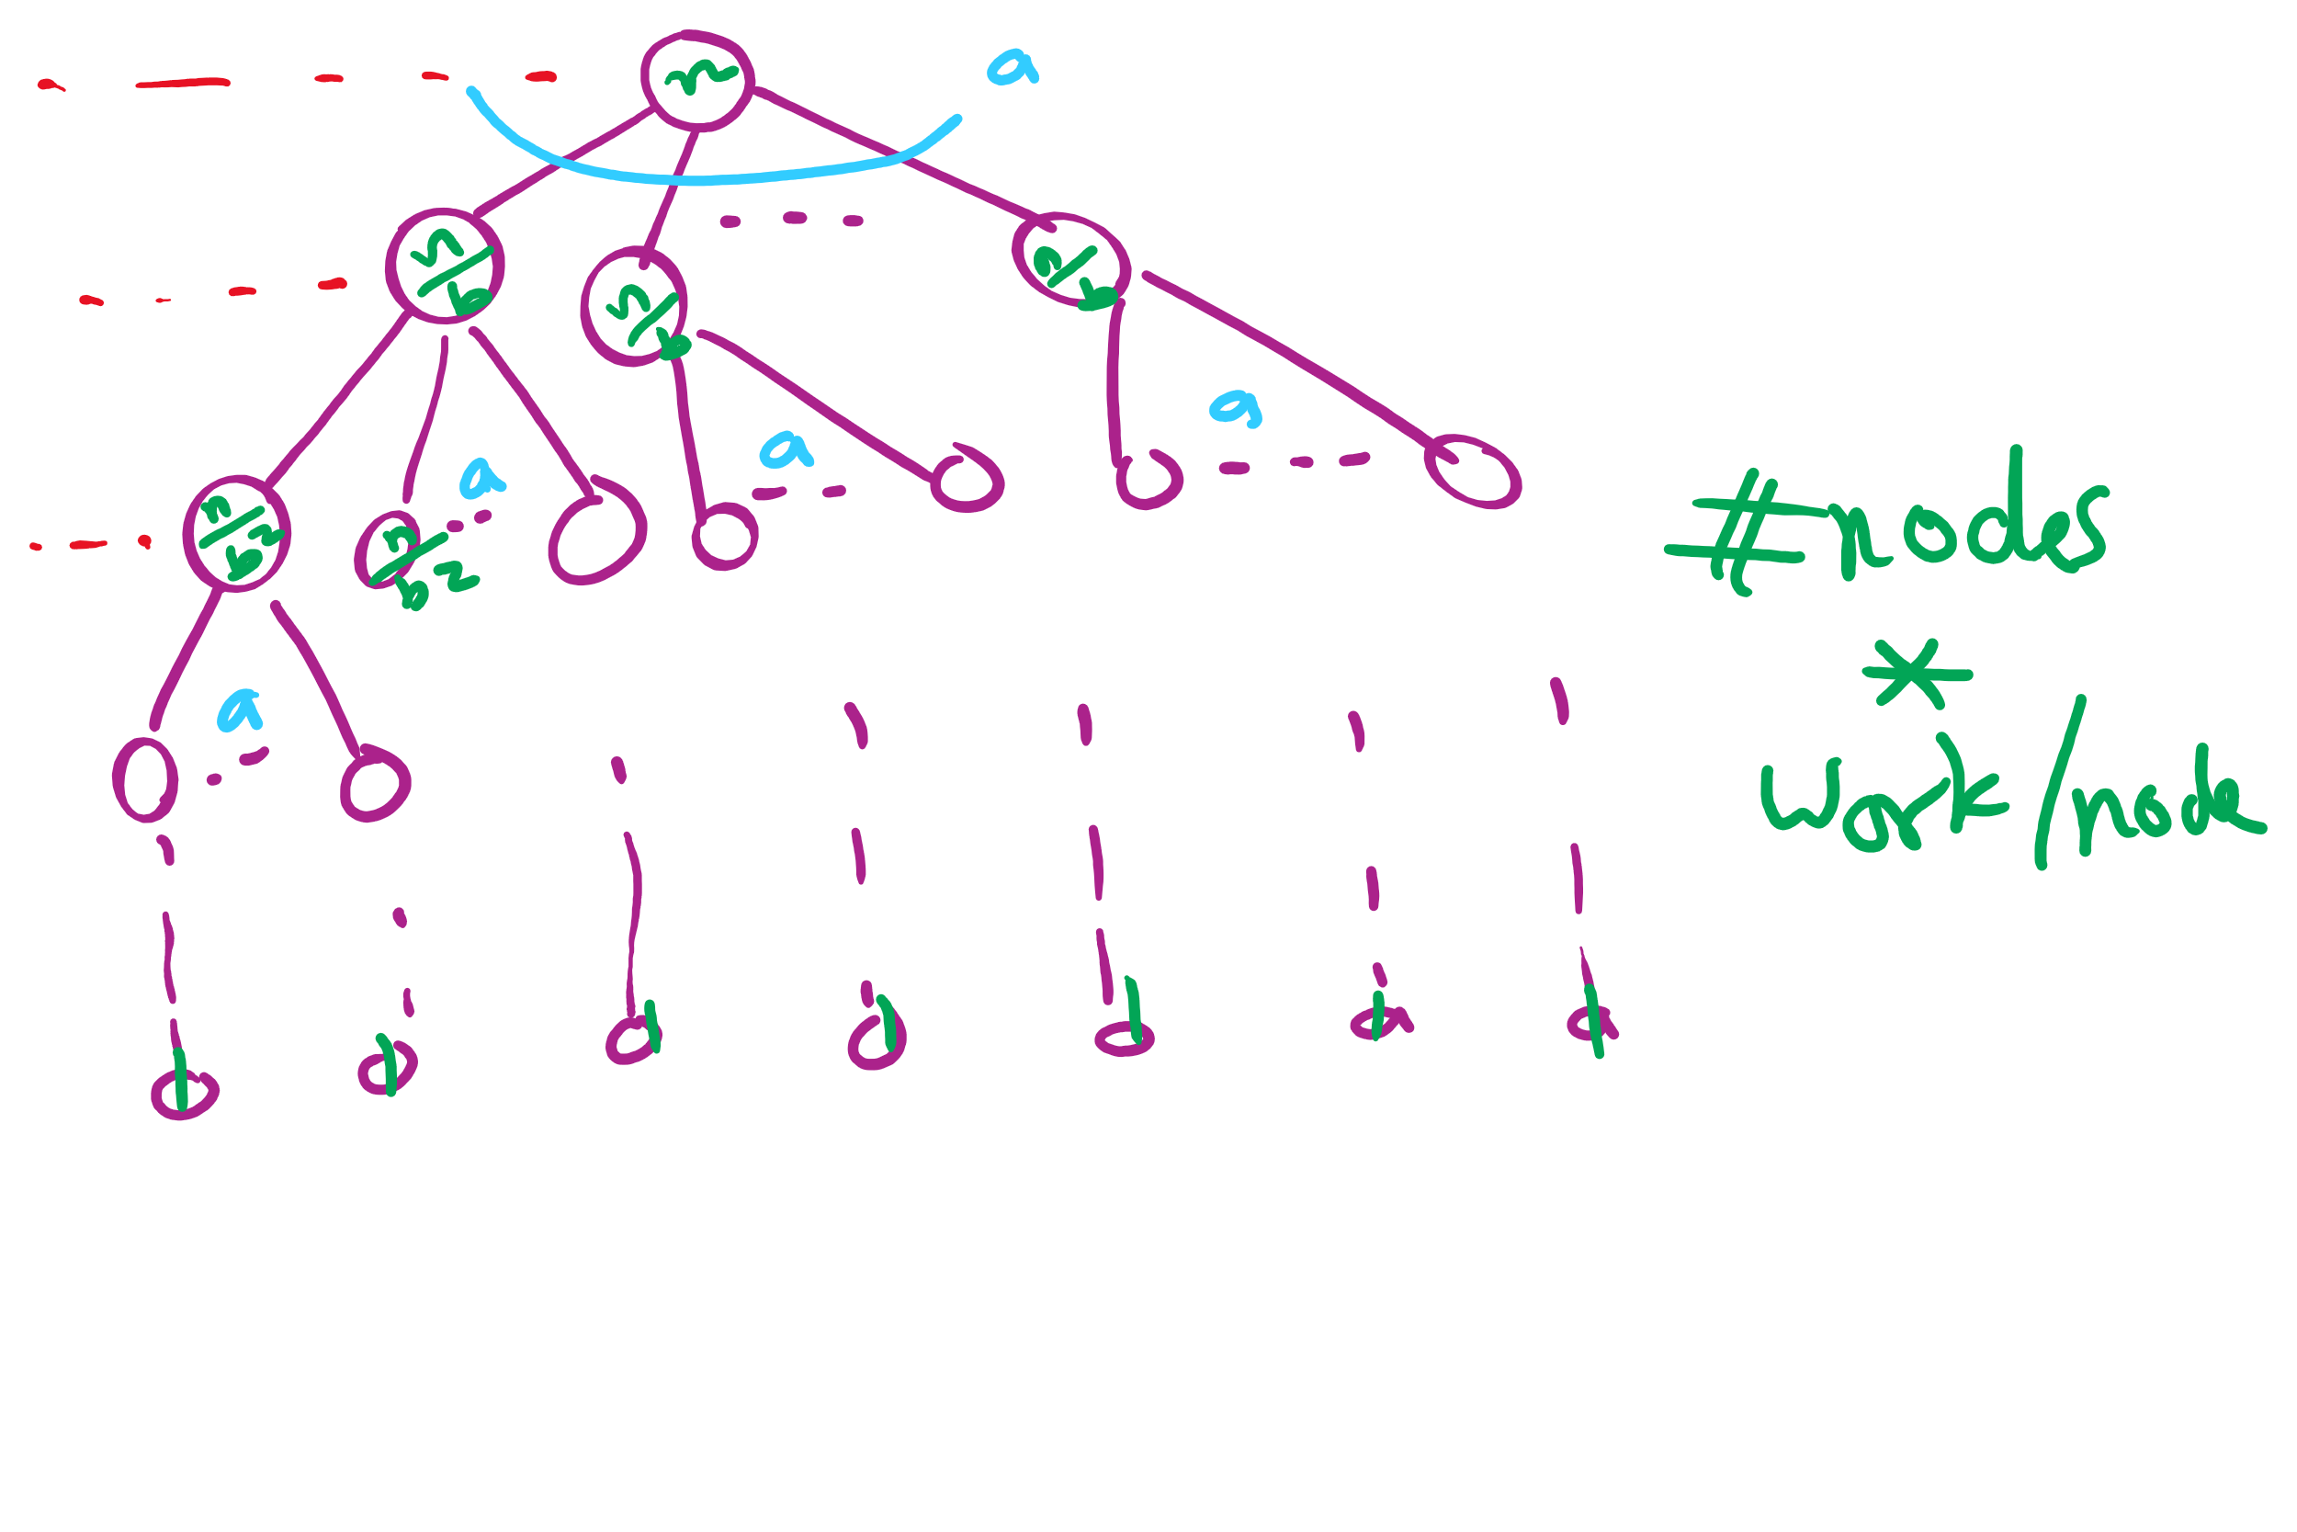
Recursion Tree

Slide 9
Applying the master theorem
T(n) = aT(n/b) + f(n)
If f(n) is O(n^{log_b(a) - ε}):
T(n) is Θ(n^{log_b(a)})
If f(n) is Θ(n^{log_b(a)})
T(n) is Θ(n^{log_b(a)} lg n)
If f(n) is Ω(n^{log_b(a) + ε}) and (a * f(n/b) <= c * f(n)) for some c < 1:
T(n) is Θ(f(n))
Notes:
T(n) = 2T(n/2) + n lg n
falls into a gap
n lg n is asymptotically larger than n, but not polynomially larger

Slide 10
Last lecture …
Max Flow implementation issues
Min Cut
(Big)Integer Algorithms
multiplication

Slide 11
Muddiest points
min cut
finding minimum st cut
Could you restate what a min cut is?
min st cut finding and duality, how does it equal max flow??
why to use min cut / max flow
Min cut implementation/actual code
Can you explain duality again?
Master Theorem
master theorem pros/cons
divide and conquer. Honestly, im very confused about the last 10 minutes content of today's lecture.
The tree of nodes at the end of the lecture
The big integer recurrence relations
Difference between recurrence relation and recursion tree and how to derive a recurrence relation

Slide 12
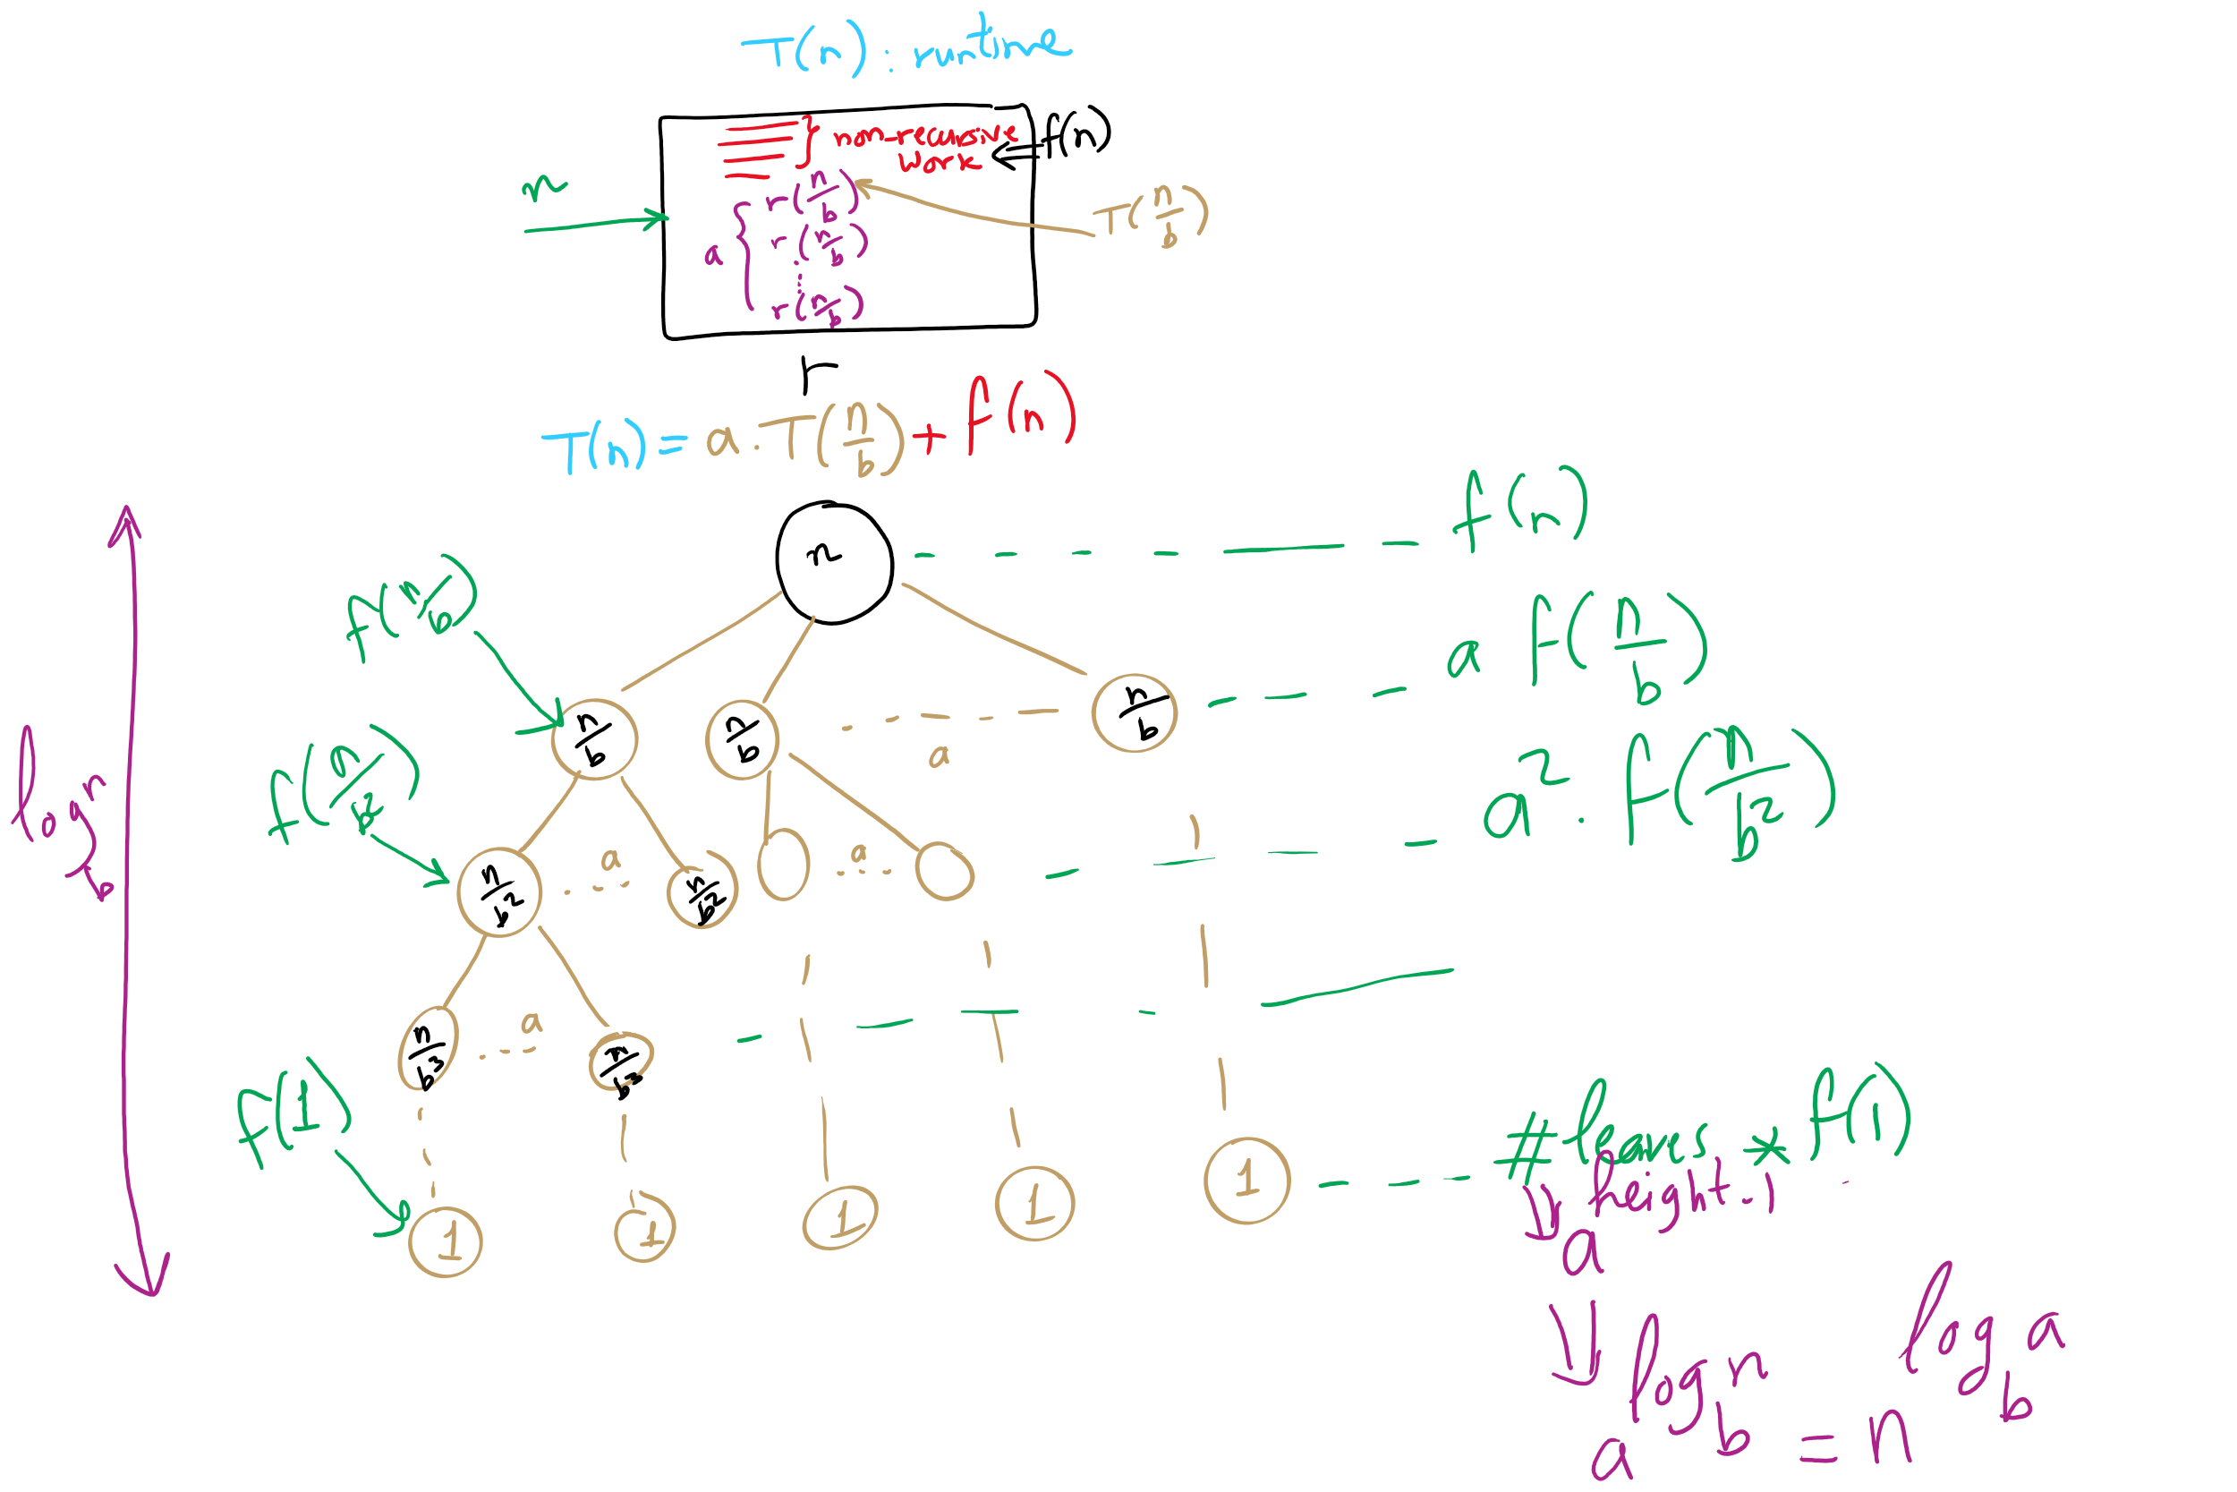
Recurrence vs. Recursion Tree

Slide 13
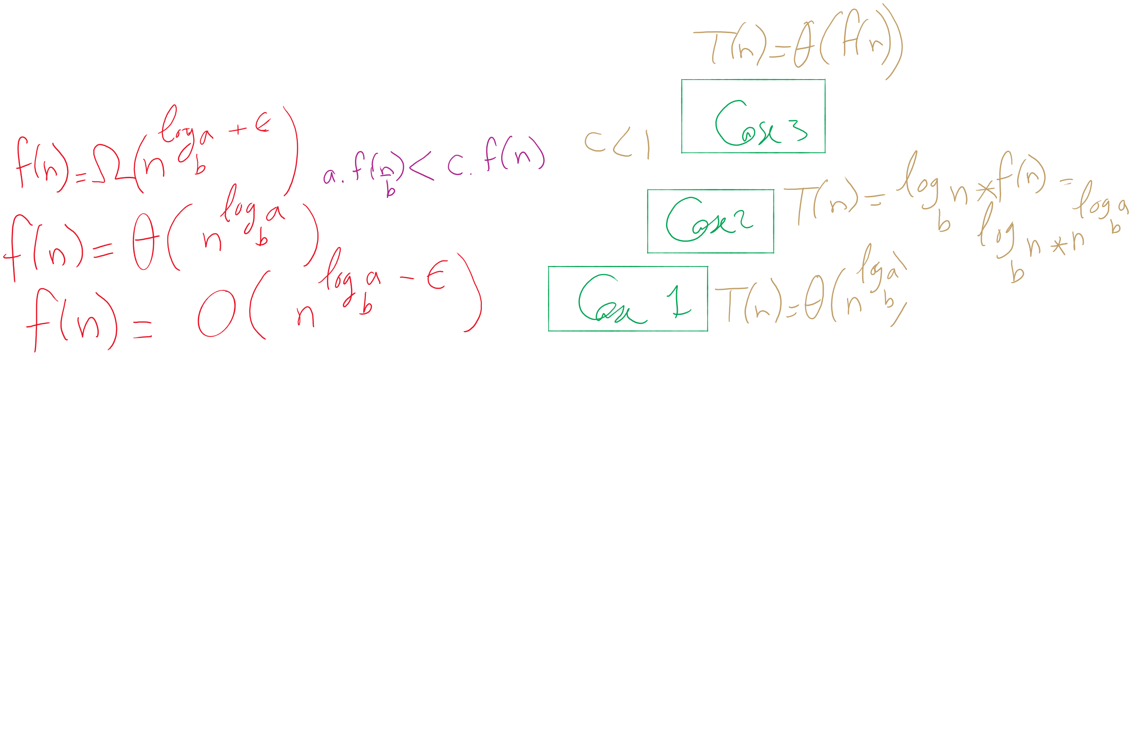


The 3 cases of the Master Theorem

Slide 14
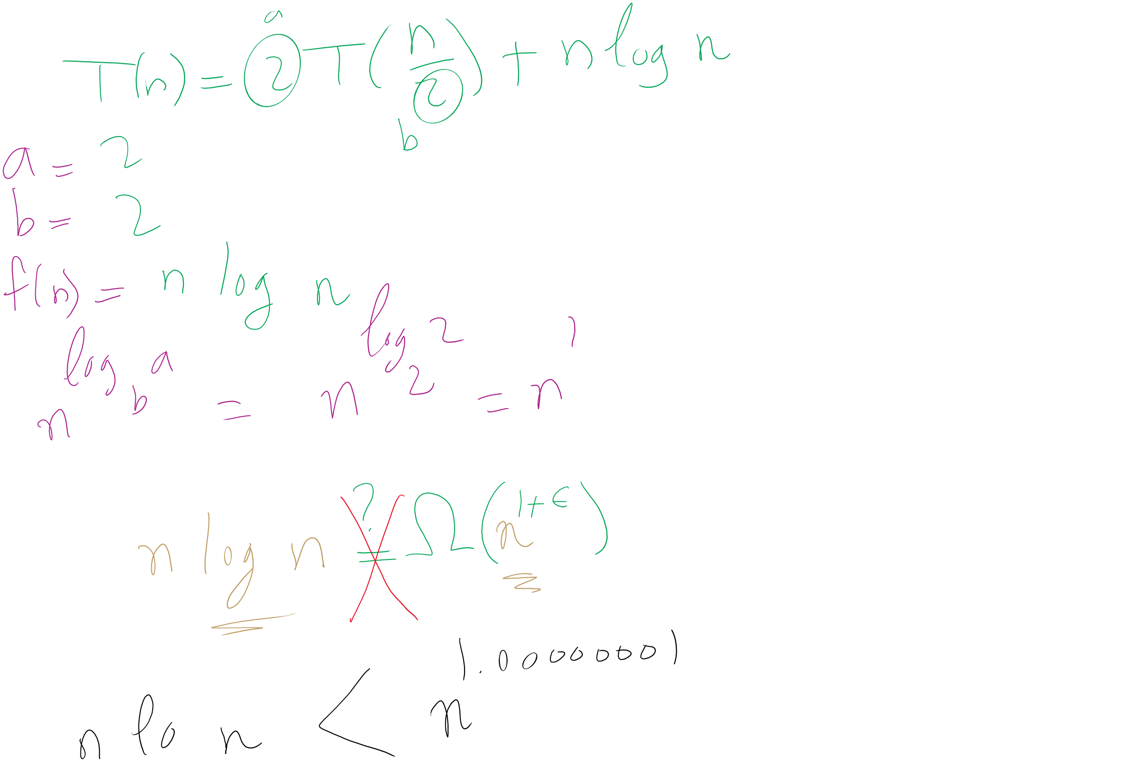
When Master Theorem doesn’t apply: Example

Slide 15
This Lecture
(Big)Integer Algorithms
Karatsuba multiplication
exponentiation
GCD
RSA encryption

Slide 16
Applying the master theorem
T(n) = aT(n/b) + f(n)
If f(n) is O(n^{log_b(a) - ε}):
T(n) is Θ(n^{log_b(a)})
If f(n) is Θ(n^{log_b(a)})
T(n) is Θ(n^{log_b(a)} lg n)
If f(n) is Ω(n^{log_b(a) + ε}) and (a * f(n/b) <= c * f(n)) for some c < 1:
T(n) is Θ(f(n))
Notes:
T(n) = 2T(n/2) + n lg n
falls into a gap
n lg n is asymptotically larger than n, but not polynomially larger

Slide 17
Mergesort master theorem analysis
Recurrence relation for mergesort?
T(n) = 2T(n/2) + Θ(n)
T(n) = 2T(n/2) + Θ(n)
If f(n) is O(n^{log_b(a) - ε}):
T(n) is Θ(n^{log_b(a)})
If f(n) is Θ(n^{log_b(a)})
T(n) is Θ(n^{log_b(a)} lg n)
If f(n) is Ω(n^{log_b(a) + ε}) and (a * f(n/b) <= c * f(n)) for some c < 1:
T(n) is Θ(f(n))
a = 2
b = 2
f(n) is Θ(n)
So...
n^{log_b(a)} = …
n^{lg 2} = n
Being Θ(n) means f(n) is Θ(n^{log_b(a)})
T(n) = Θ(n^{log_b(a)} lg n) = Θ(n^{lg 2} lg n) = Θ(n lg n)

Slide 18
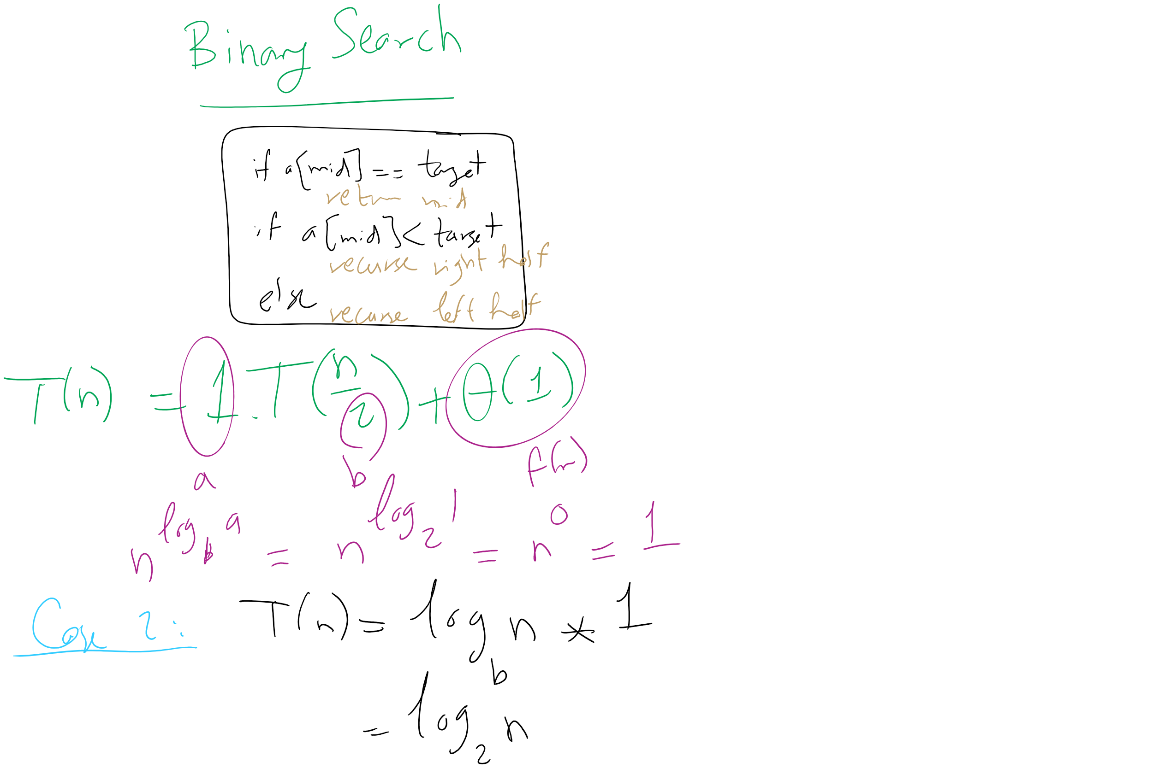
Binary Search Master Theorem Analysis

Slide 19
For our divide and conquer multiplication approach
T(n) = 4T(n/2) + Θ(n)
a = 4
b = 2
f(n) is Θ(n)
So...
n^{log_b(a)} = …
n^{lg 4} = n²
If f(n) is O(n^{log_b(a) - ε}):
T(n) is Θ(n^{log_b(a)})
If f(n) is Θ(n^{log_b(a)})
T(n) is Θ(n^{log_b(a)} lg n)
If f(n) is Ω(n^{log_b(a) + ε}) and (a * f(n/b) <= c * f(n)) for some c < 1:
T(n) is Θ(f(n))
Being Θ(n) means f(n) is polynomially smaller than n²
T(n) = Θ(n^{log_b(a)}) = Θ(n^{lg 4}) = Θ(n²)

Slide 20
@#$%^&*
Leaves us back where we started with the grade school algorithm…
Actually, the overhead of doing all of the dividing and conquering will make it slower than grade school

Slide 21
SO WHY EVEN BOTHER?
Let’s look for a smarter way to divide and conquer
Look at the recurrence relation again to see where we can improve our runtime:
T(n) = 4T(n/2) + Θ(n)
Can we reduce the amount of work done by the current call?
Can we reduce the number of subproblems?
Can we reduce the subproblem size?

Slide 22
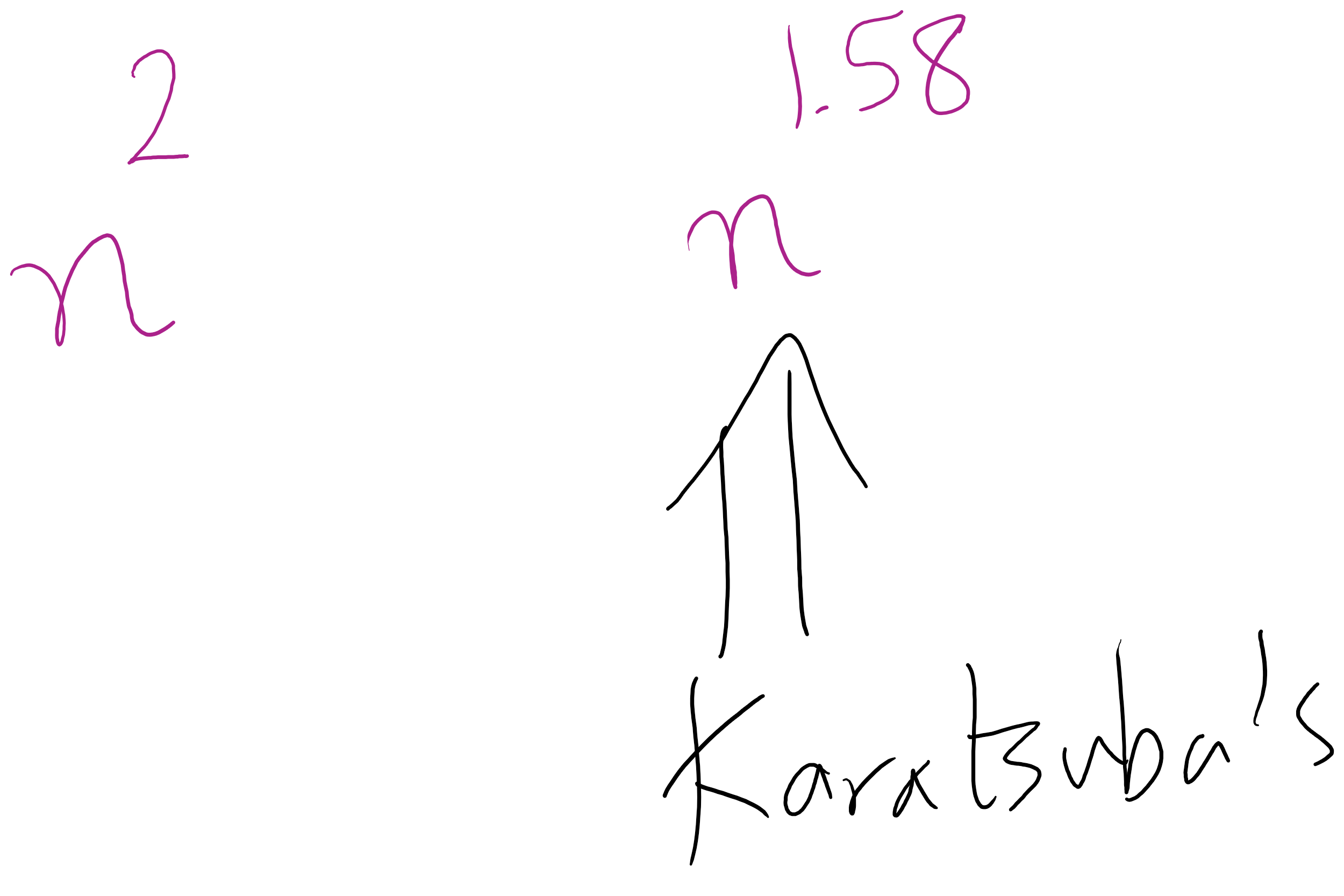
Karatsuba runtime
To get M5, we have to multiply (at most) n/2 + 1 bit ints
Asymptotically the same as our other recursive calls
Requires extra additions and subtractions…
But these are all Θ(n)
So, the recurrence relation for Karatsuba’s algorithm is:
T(n) = 3T(n/2) + Θ(n)
Which solves to be Θ(n^{lg 3})
Asymptotic improvement over grade school algorithm!
For large n, this will translate into practical improvement

Slide 23
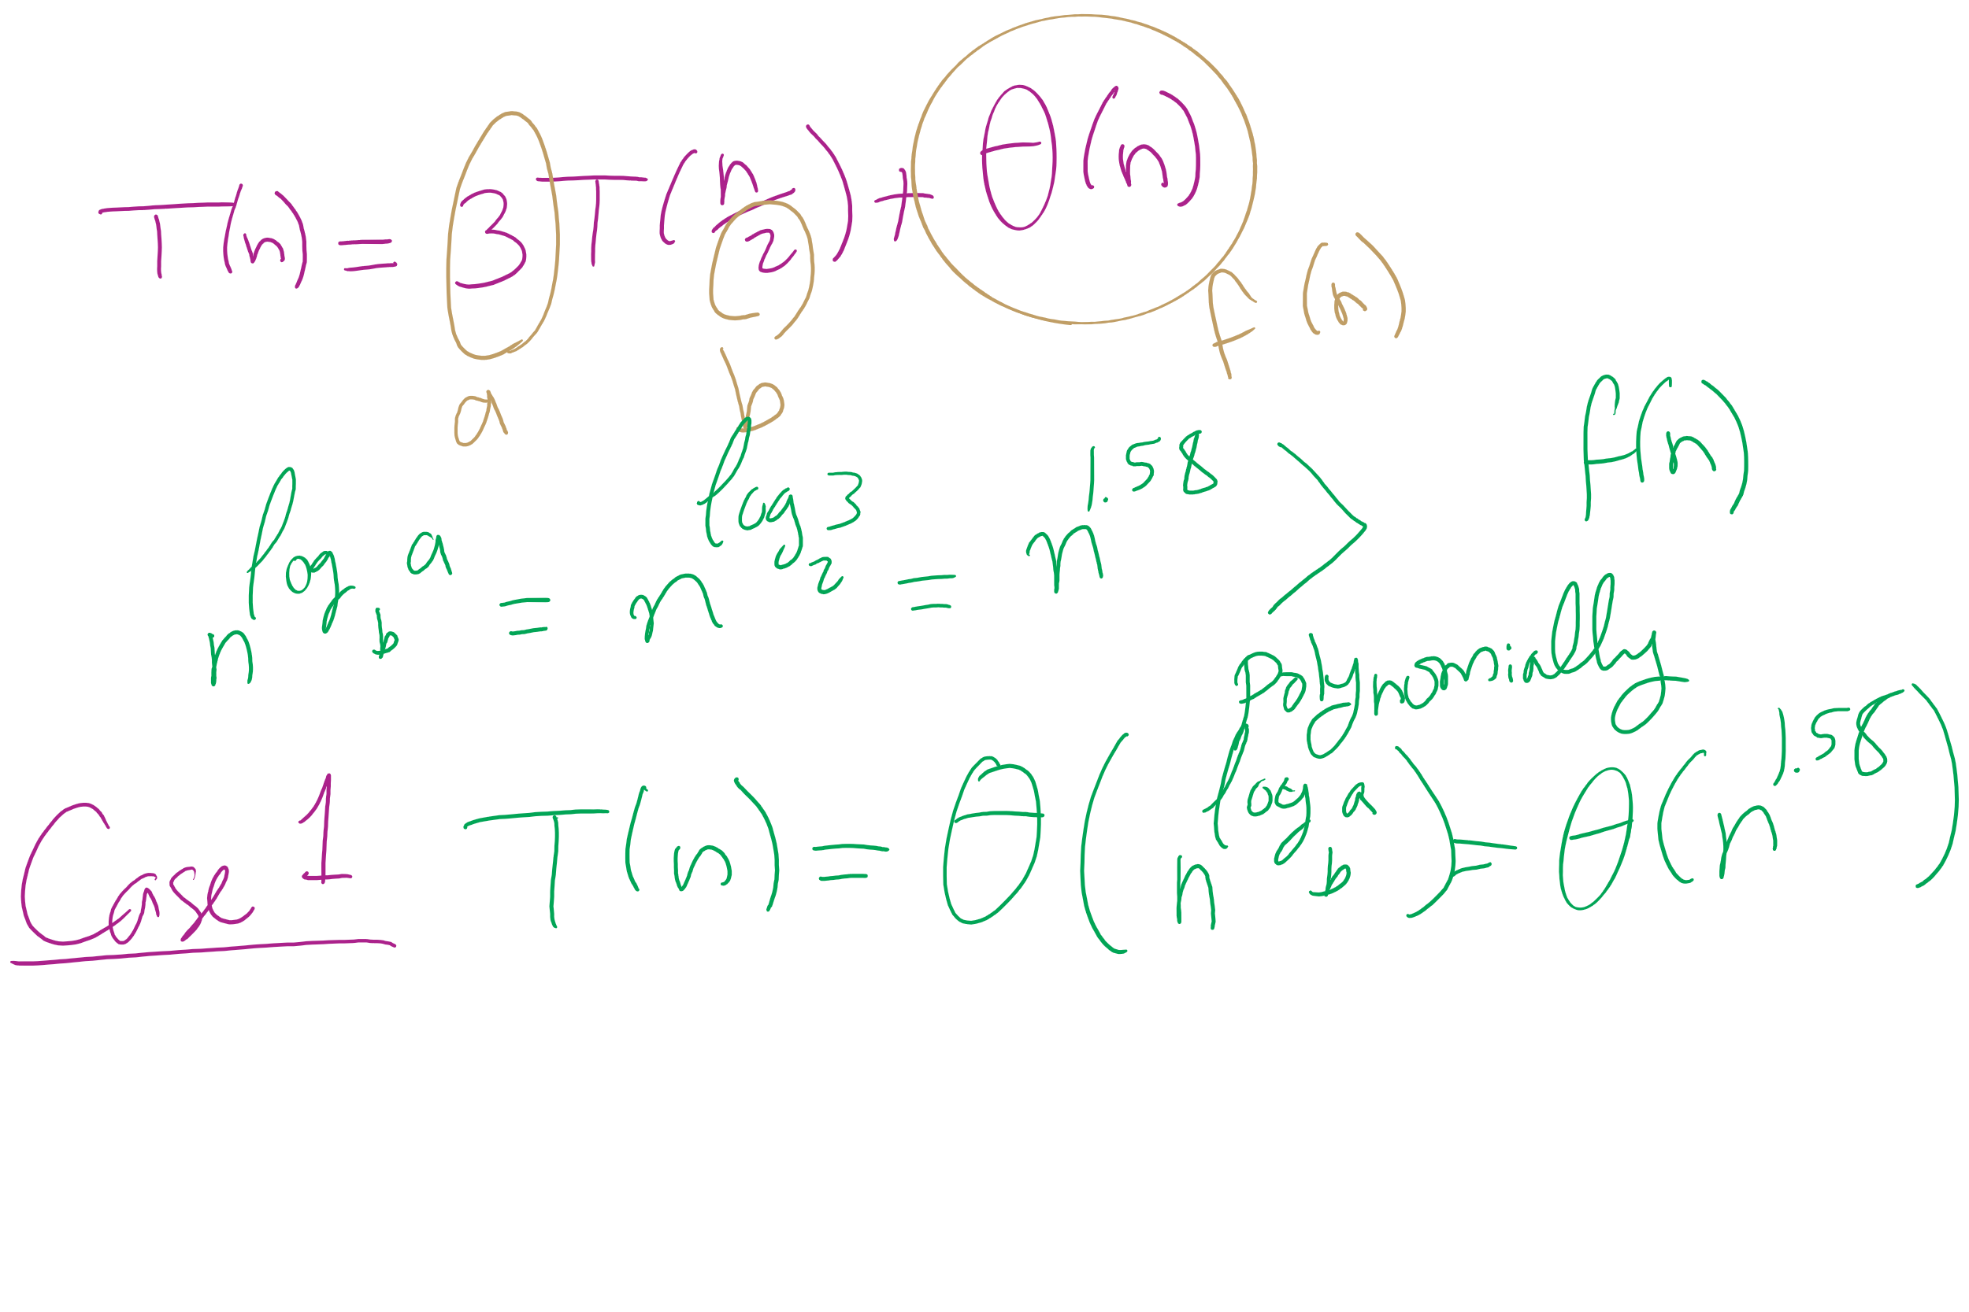
Karatsuba Runtime

Slide 24
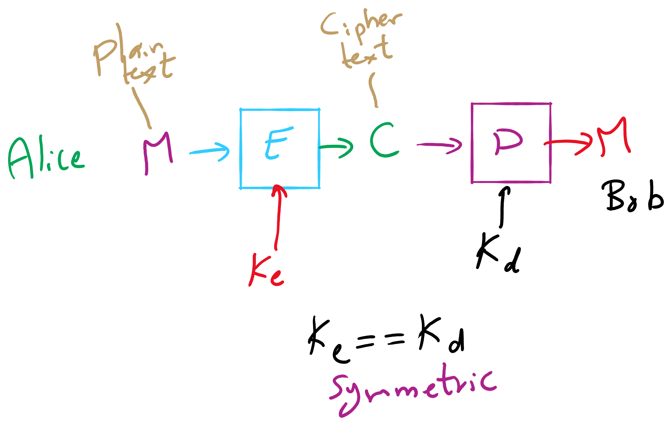
Encryption Model

Slide 25
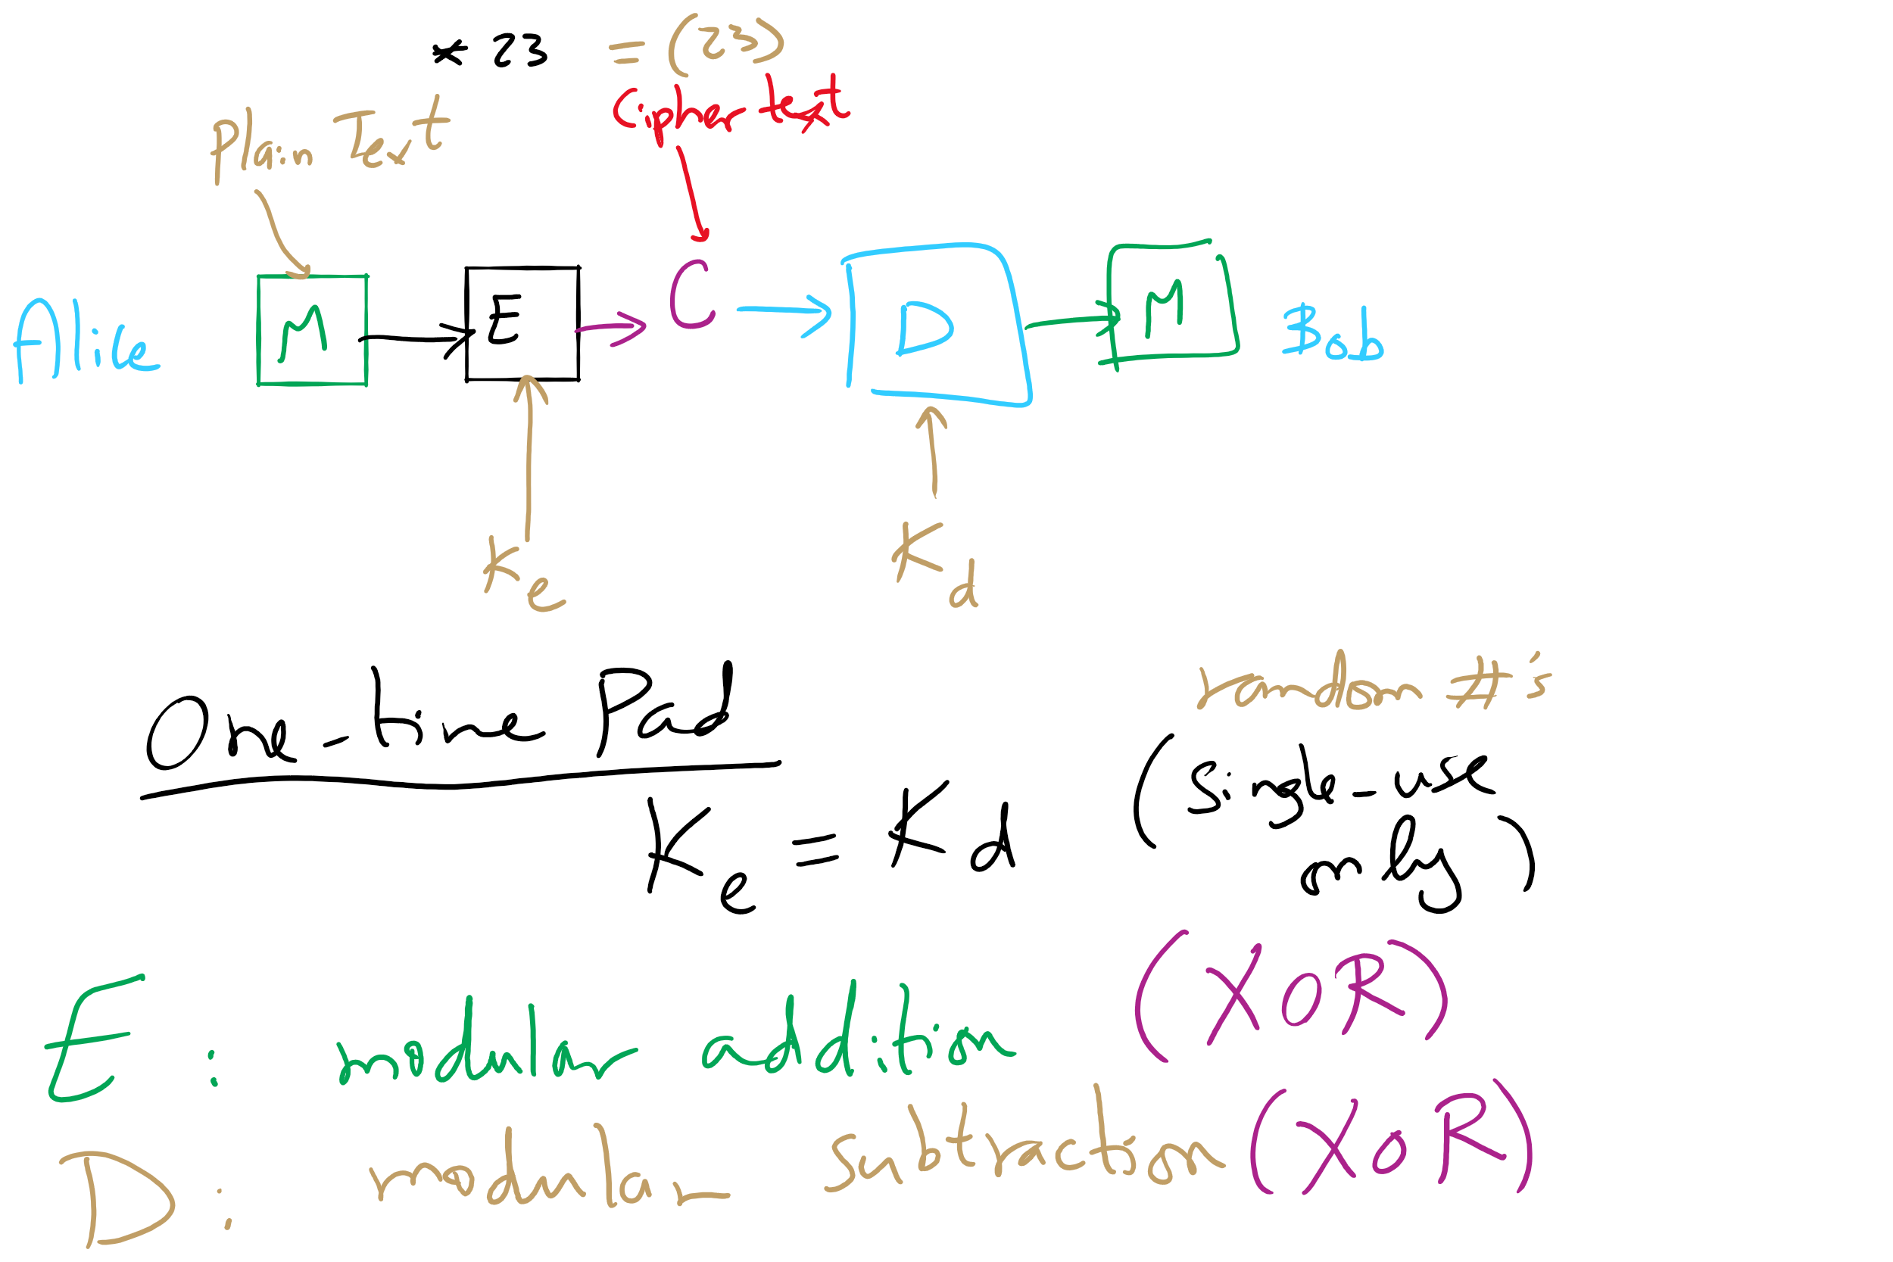
One-Time Pad

Slide 26
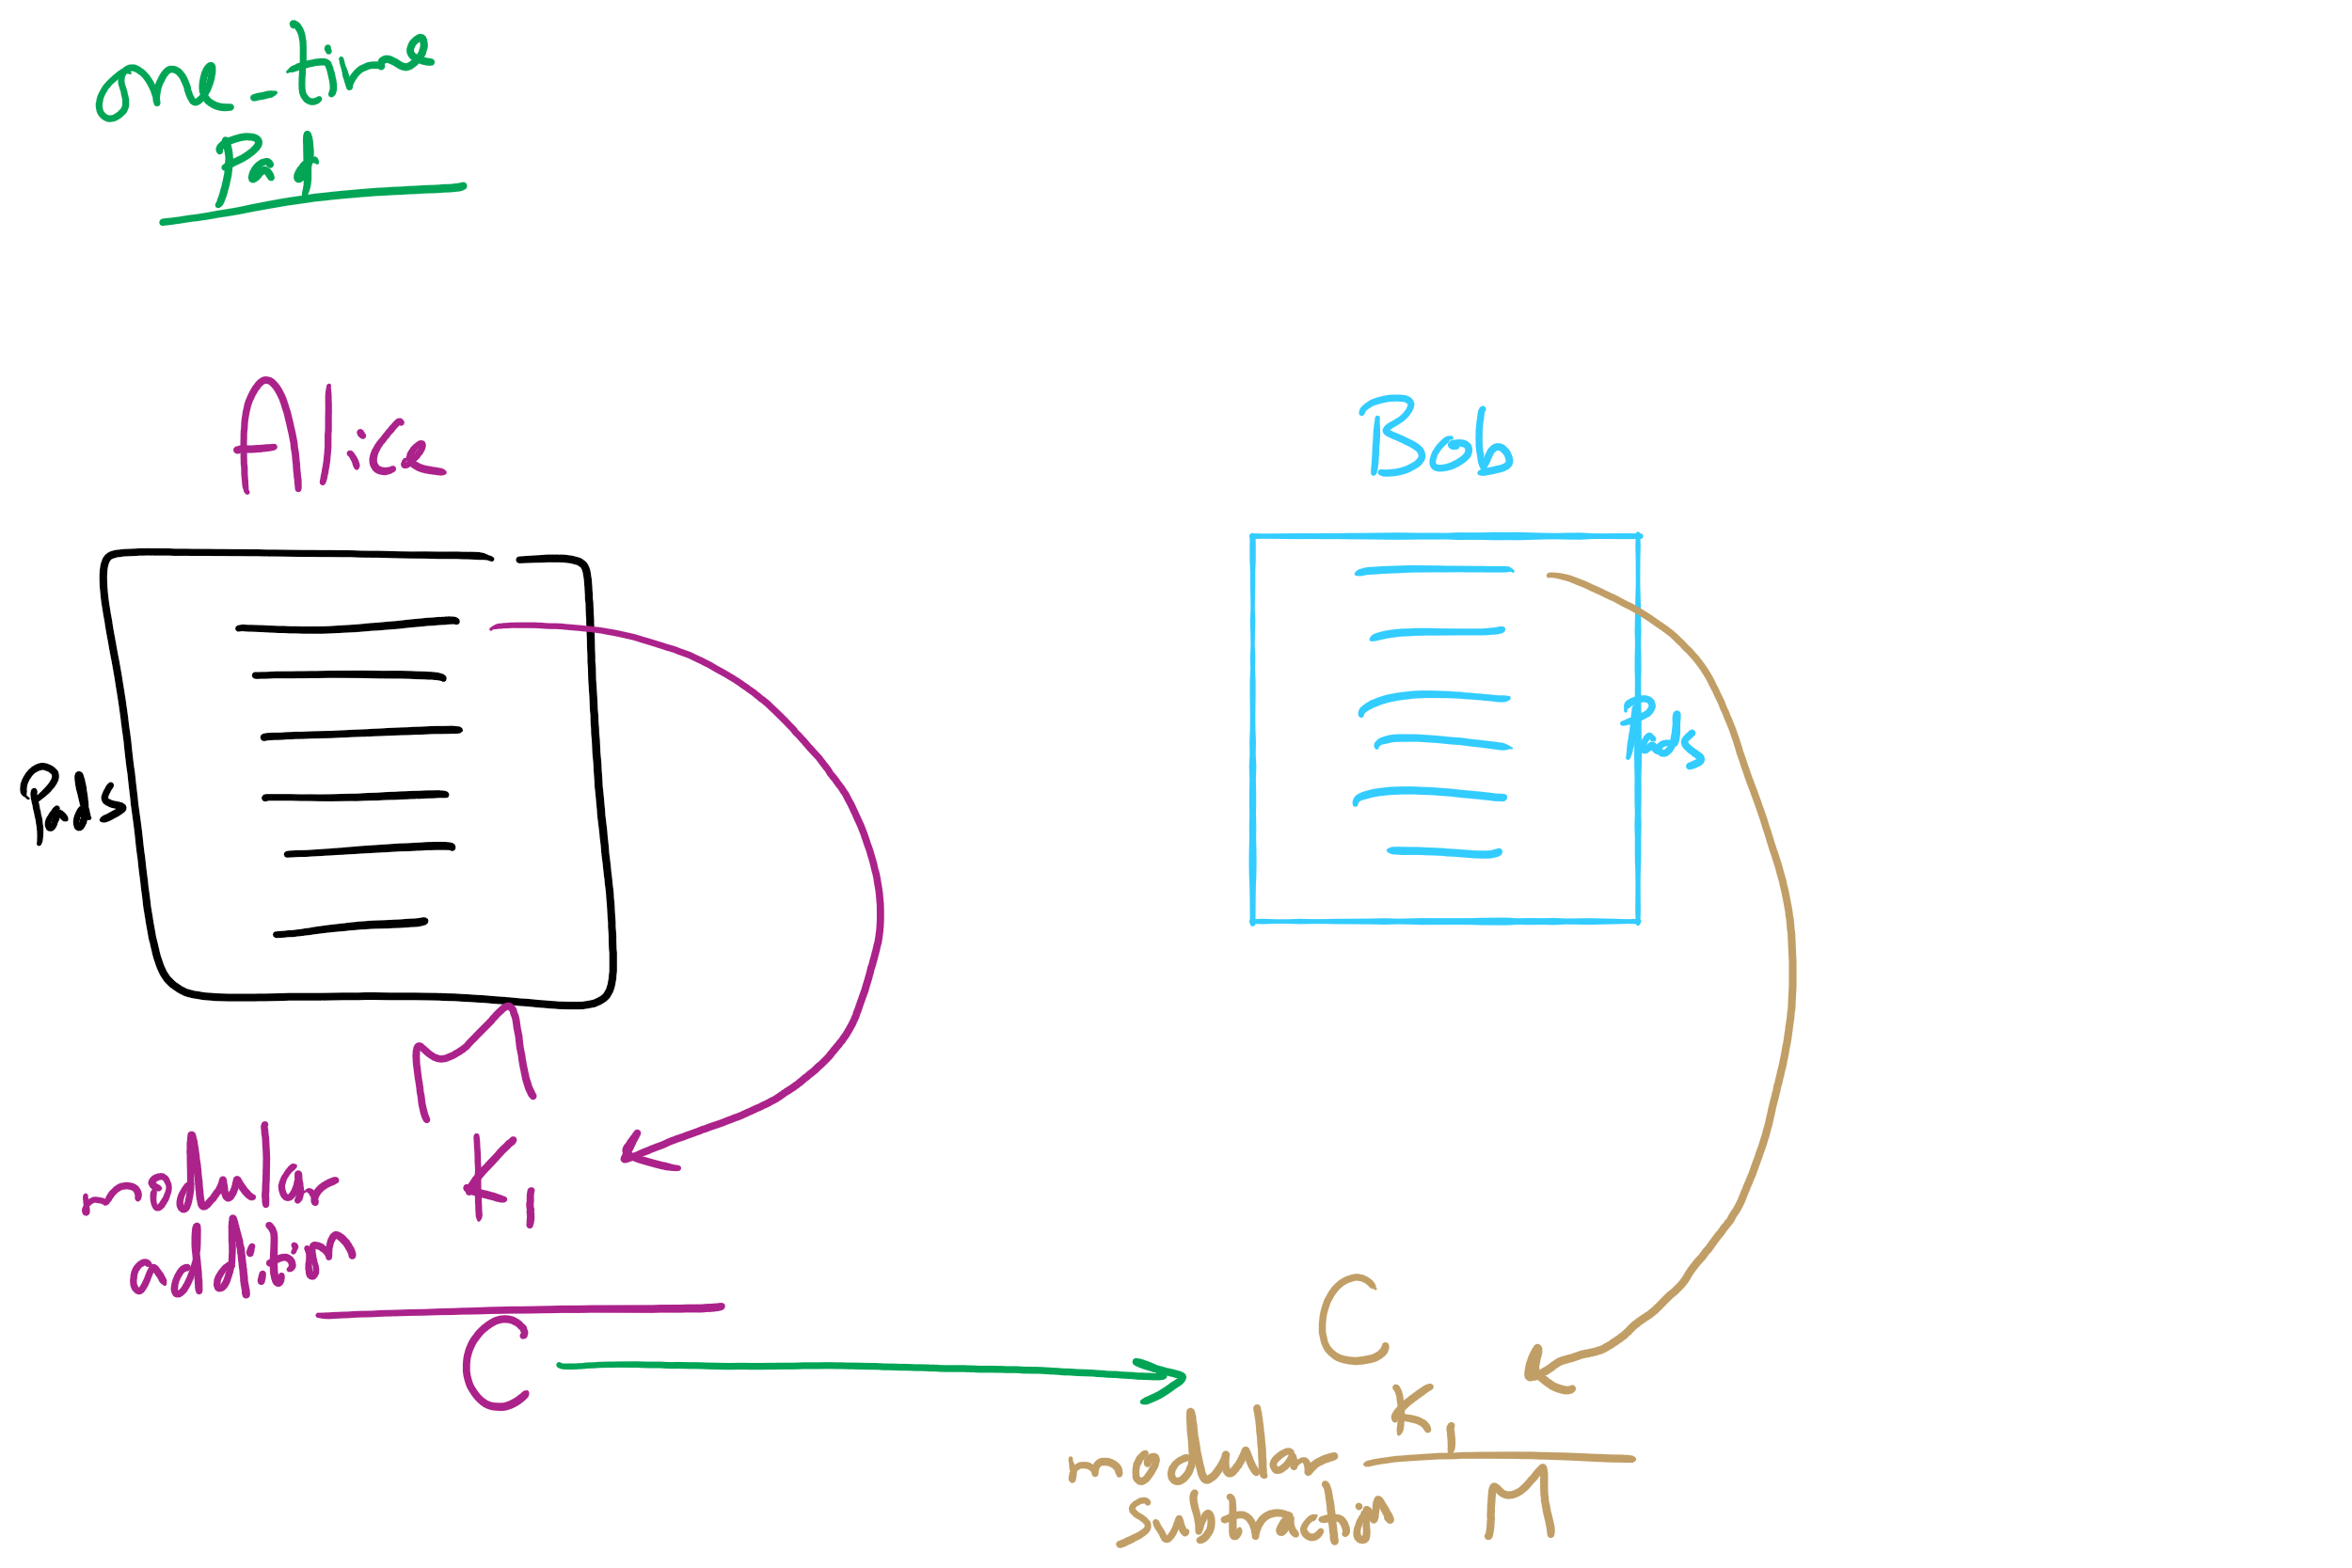
One-Time Pad

Slide 27
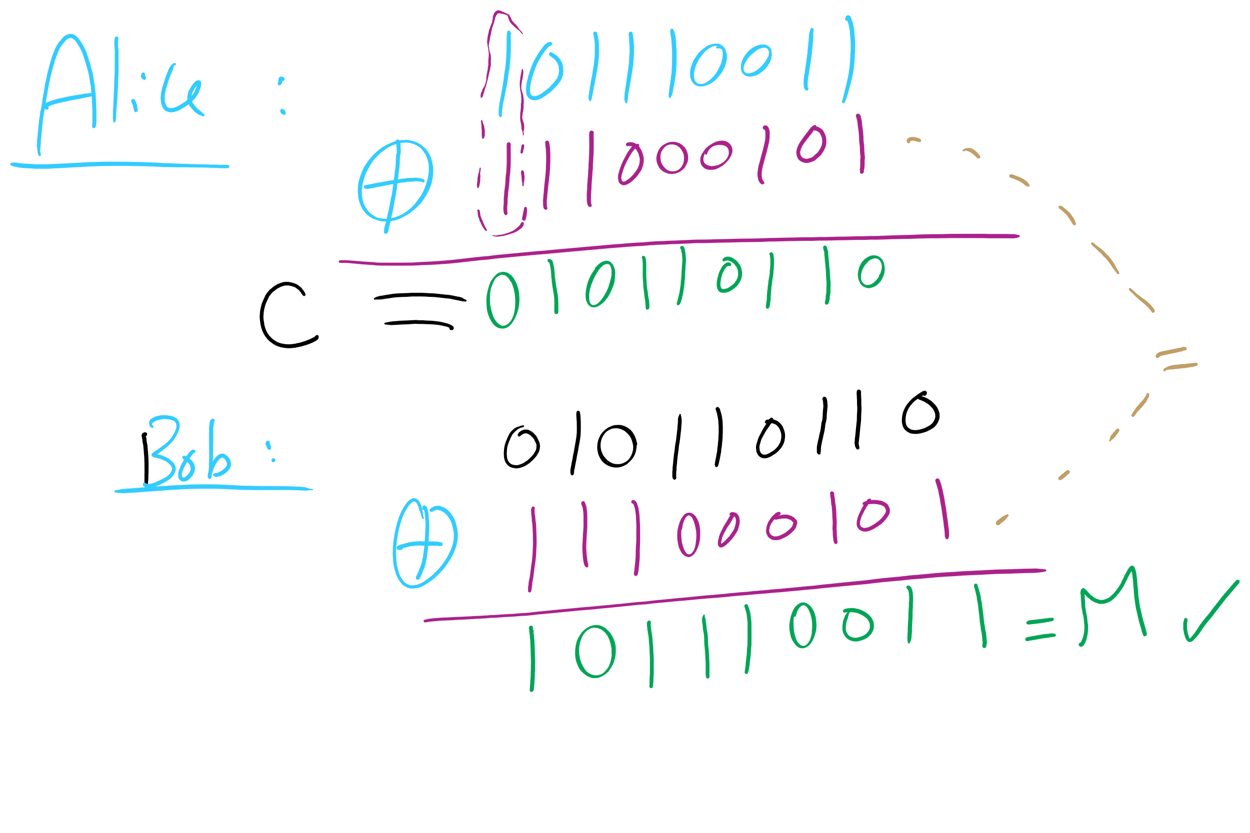
One-Time Pad Example 1

Slide 28
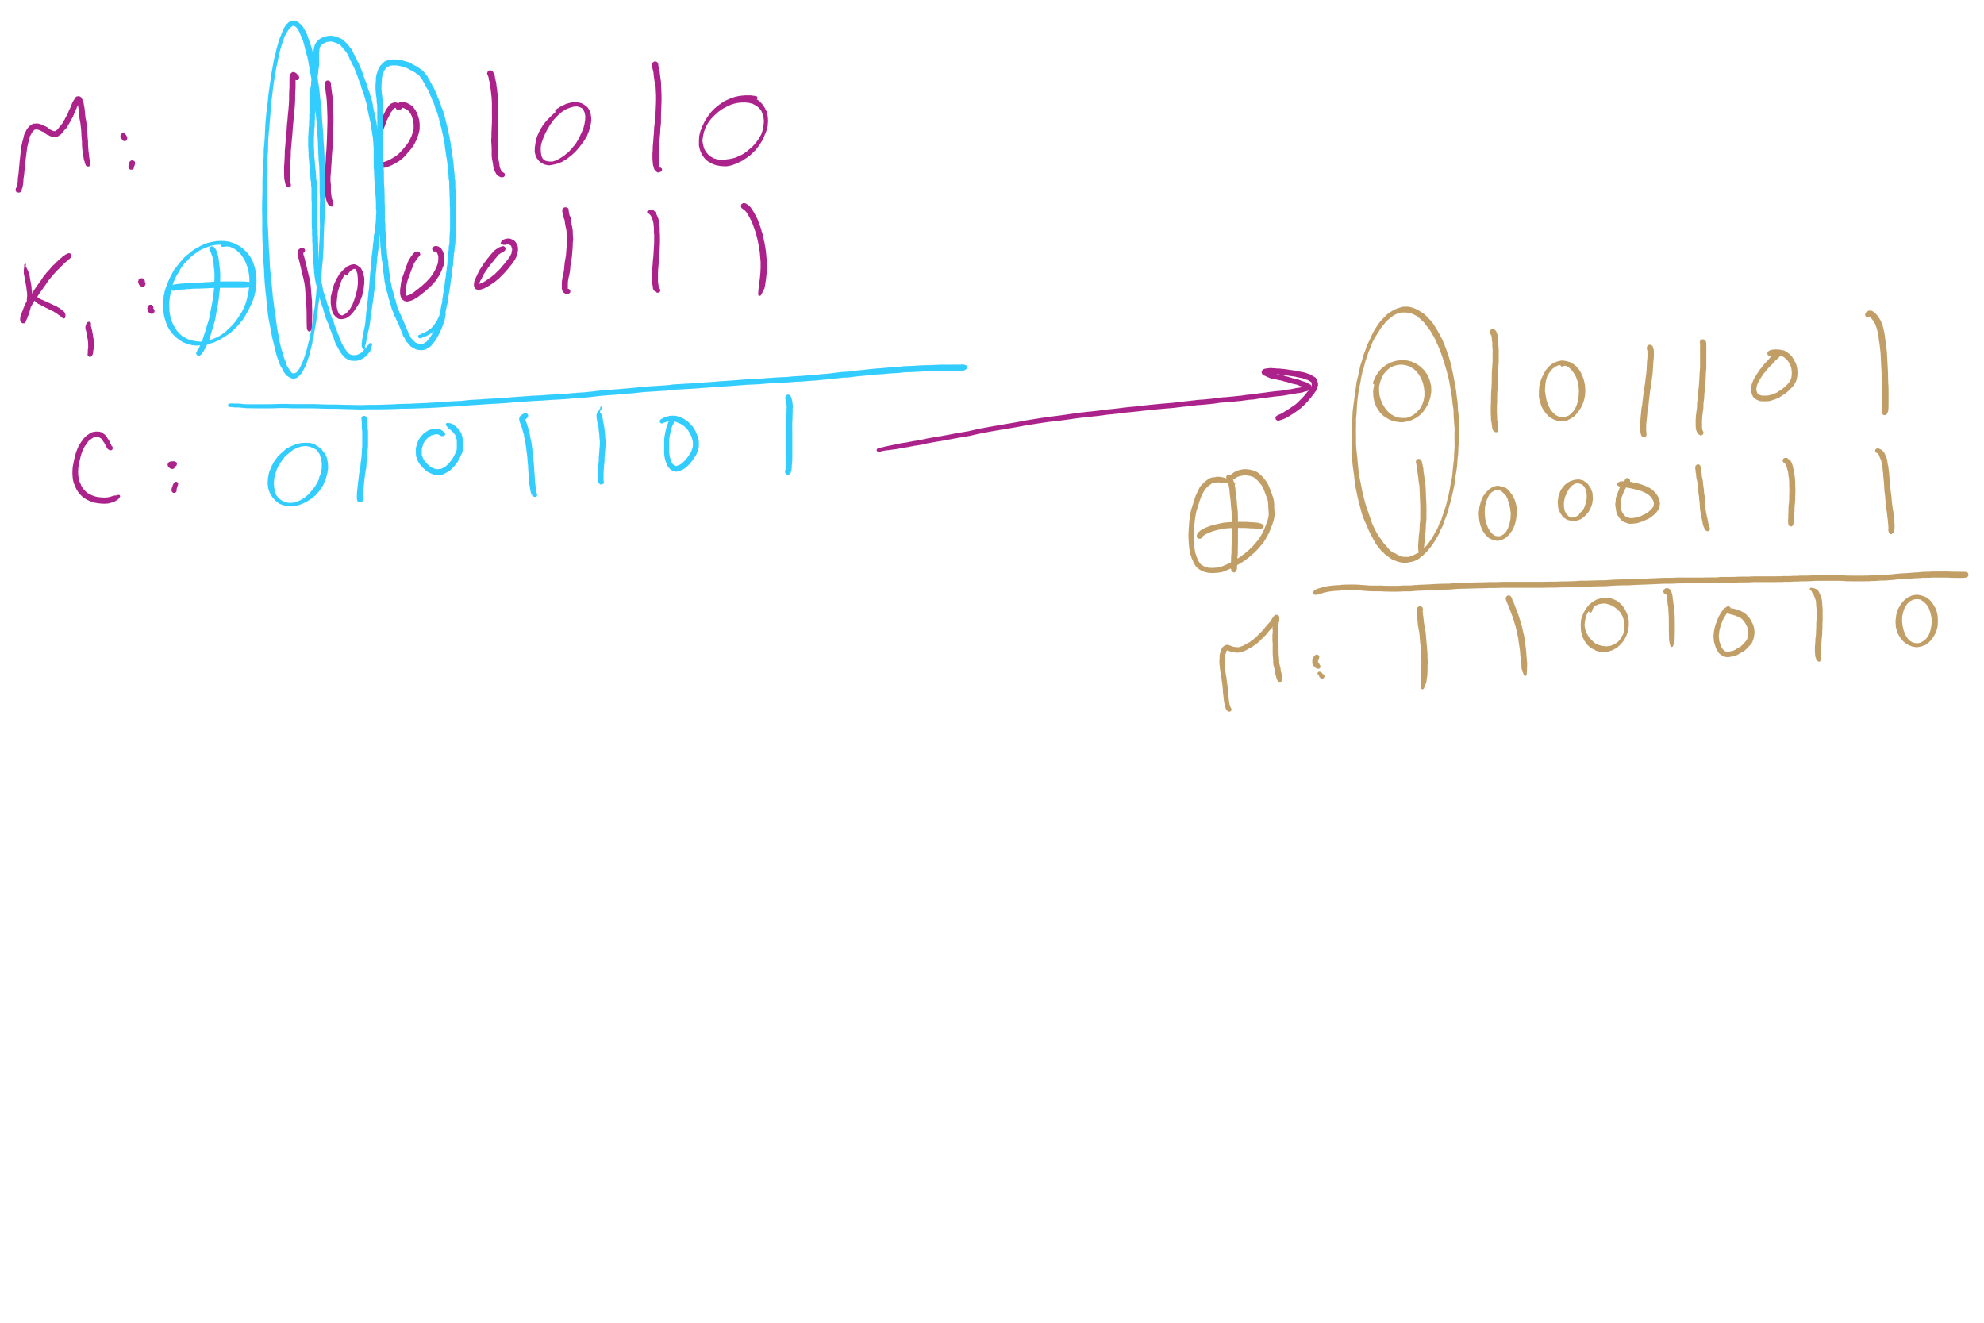
One-Time Pad Example 2

Slide 29
This Lecture
(Big)Integer Algorithms
RSA encryption
Dynamic Programming

Slide 30
Difficulties with one-time pads
Pads must be truly random
Both sender and receiver must have a matched list of pads in the appropriate order
Once you run out of pads, no more messages can be sent

Slide 31
Symmetric ciphers
Alice
M
Encrypt
C
Decrypt
M
Bob
K
K
E.g., DES, AES, Blowfish
Users share a single key
Numbers of a given bitlength (e.g., 128, 256)
Key is used to encrypt/decrypt many messages back and forth
Encryptions/decryptions will be fast
Typically linear in the size the input
Ciphertext should appear random
Best way to recover plaintext should be a brute force attack on the encryption key
Which we have shown to be infeasible for 128bit AES keys

Slide 32
Problems with symmetric ciphers
Alice and Bob have to both know the same key
How can you securely transmit the key from Alice to Bob?
Further, if Alice also wants to communicate with Charlie, her and Charlie will need to know the same key, a different key from the key Alice shares with Bob
Alice and Danielle will also have to share a different key…
etc.

Slide 33
Enter public-key encryption
Each user has their own pair of keys
A public key that can be revealed to anyone
A private key that only they should know
How does this solve our problem?
Public key can simply be published/advertised
Posted repositories of public keys
Added to an email signature
Each user is responsible only for their own keypair
Let's look at a public-key crypto scheme in detail...

Slide 34
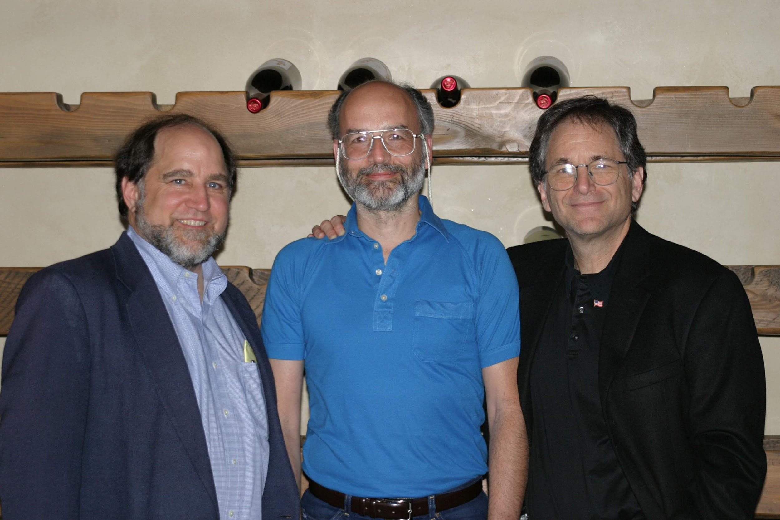
RSA
Notes:
Ronald Rivest, Adi Shamir, Leonard Adleman

Slide 35
RSA Cryptosystem in-depth
What are RSA keypairs?
How messages encrypted?
How are messages decrypted?
How are keys generated?
Why is it secure?

Slide 36
RSA keypairs
Public key is two numbers, which we will call n and e
Private key is a single number we will call d
The length of n in bits is the key length
I.e., 2048 bit RSA keys will have a 2048 bit n value
Note that "n" will be used to indicate the RSA public key component for our discussion of RSA...

Slide 37
Encryption
Say Alice wants to send a message to Bob
Looks up Bob’s public key
Convert the message into an integer: m
Compute the ciphertext c as:
c = m^{e} (mod n)
Send c to Bob

Slide 38
Decryption
Bob can simply:
Compute m as:
m = c^{d} (mod n)
Convert m into Alice’s message

Slide 39


Slide 40
n, e, and d need to be carefully generated
Choose two prime numbers p and q
Compute n = p * q
Compute φ(n)
φ(n) = φ(p) * φ(q) = (p - 1) * (q - 1)
Choose e such that
1 < e < φ(n)
GCD(e, φ(n)) = 1
I.e., e and φ(n) are co-prime
Determine d as d = e⁻¹ mod(φ(n))

Slide 41
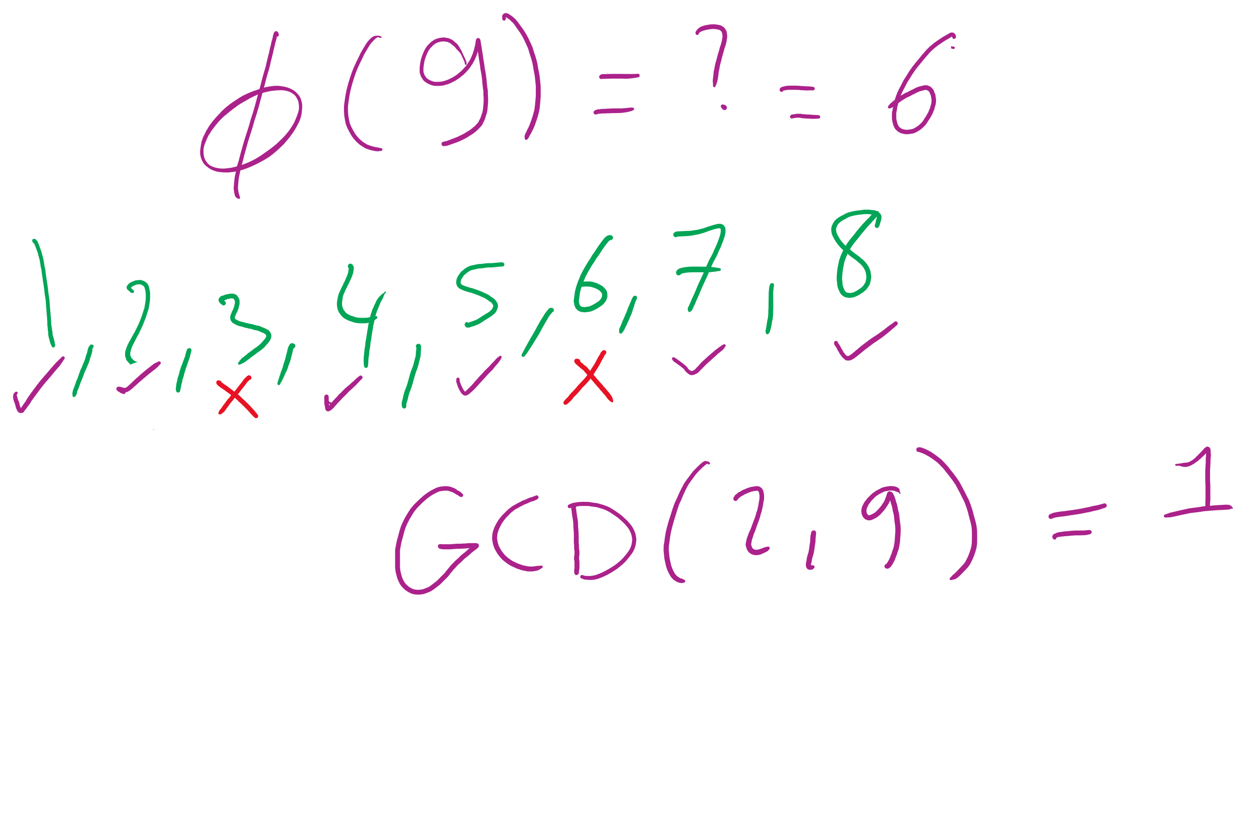
What the φ?
Here, we mean φ to be Euler’s totient
φ(n) is a count of the integers < n that are co-prime to n
I.e., how many k are there such that:
1 <= k <= n AND GCD(n, k) = 1
p and q are prime..
Hence, φ(p) = p - 1 and φ(q) = q -1
Further, φ is multiplicative
Since p and q are prime, they are co-prime, so
φ(p) * φ(q) = φ(p * q) = φ(n)
I won’t detail the proof here...

Slide 42
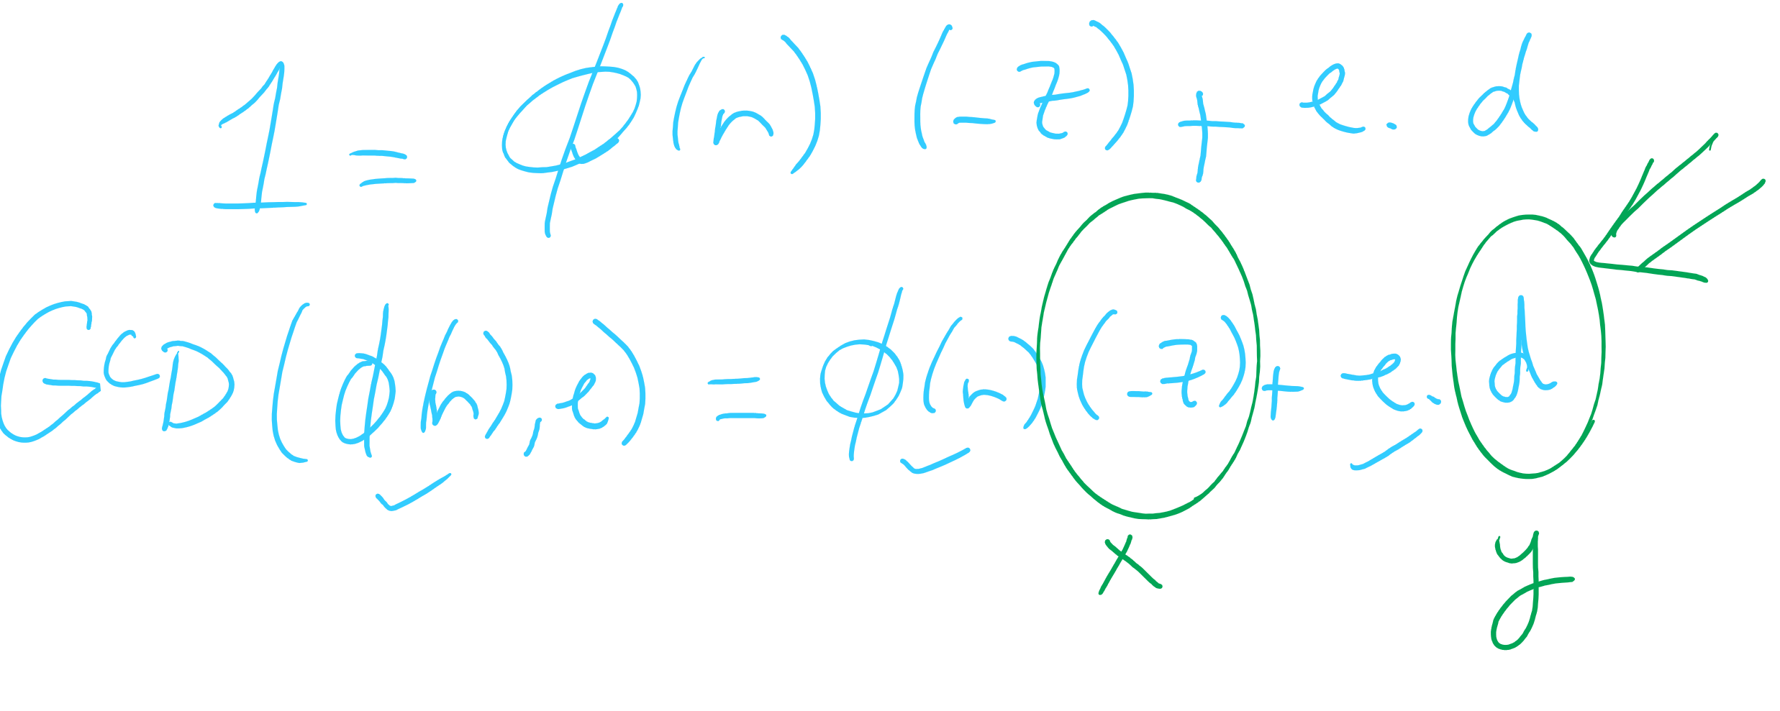
OK, now what about multiplicative inverses mod φ(n)?
d = e⁻¹ mod(φ(n))
Means that d = 1/e mod(φ(n))
Means that e * d = 1 (mod φ(n))
Now, this can be equivalently stated as e * d = z * φ(n) + 1
For some z
Can further restate this as: e * d - z * φ(n) = 1
Or similarly: 1 = φ(n) * (-z) + e * d
How can we solve this?
Hint: recall that we know GCD(φ(n), e) = 1

Slide 43
Use extended Euclidean algorithm!
GCD(a, b) = i = ax + by
Let:
a = φ(n)
b = e
x = -z
y = d
i = 1
GCD(φ(n), e) = 1 = φ(n) * (-z) + e * d
We can compute d in linear time!

Slide 44
RSA keypair example notes
p and q must be prime
n = p * q
φ(n) = (p - 1) * (q - 1)
Choose e such that
1 < e < φ(n) and GCD(e, φ(n)) = 1
Solve XGCD(φ(n), e) = 1 = φ(n) * (-z) + e * d
Compute the ciphertext c as:
c = m^{e} (mod n)
Recover m as:
m = c^{d} (mod n)
Notes:
Ready (( … )**13) % 77 in a python prompt
Advertise public key (n=77, e=37)
Request an encrypted message
What does the mod n mean for possible messages to encrypt??
Show result
Step through key gen process
p = 7, q = 11
n = 77
φ(n) = 60
select e to be 37
co-prime to 60
XGCD(60, 37) = 1 = 60 * -8 + 37 * 13
d = 13

Slide 45
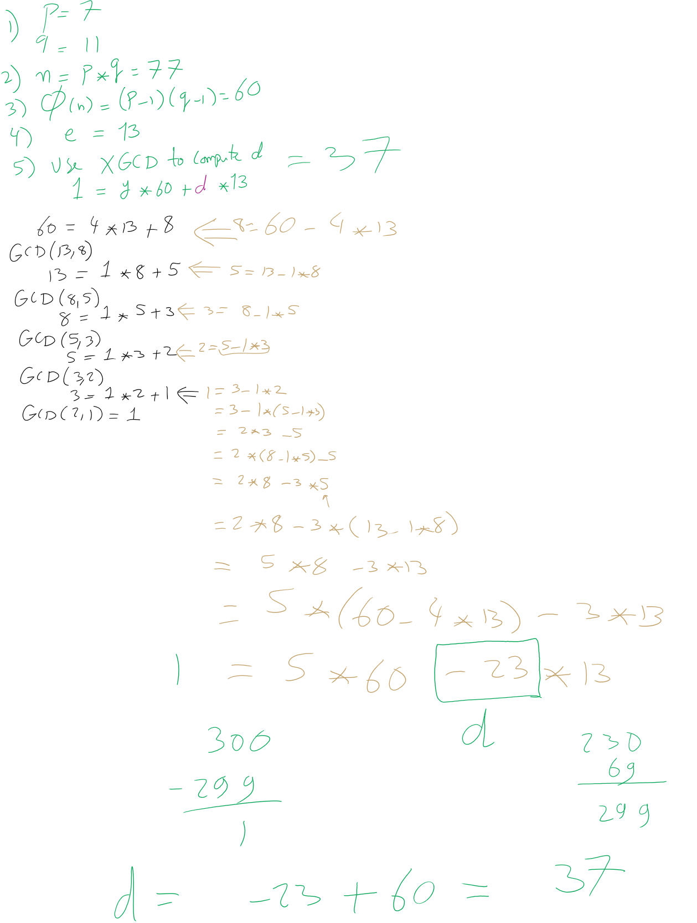
RSA Example 1

Slide 46
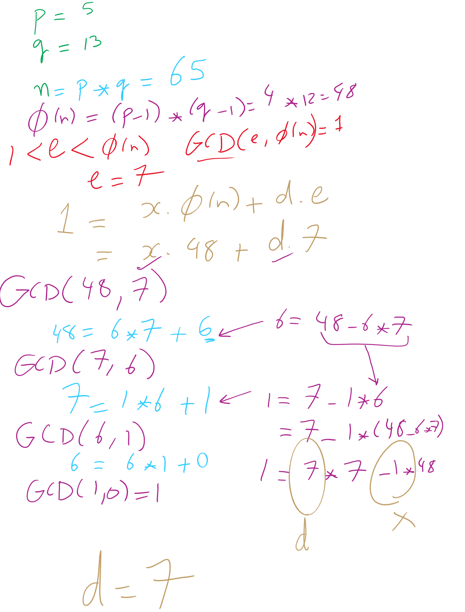
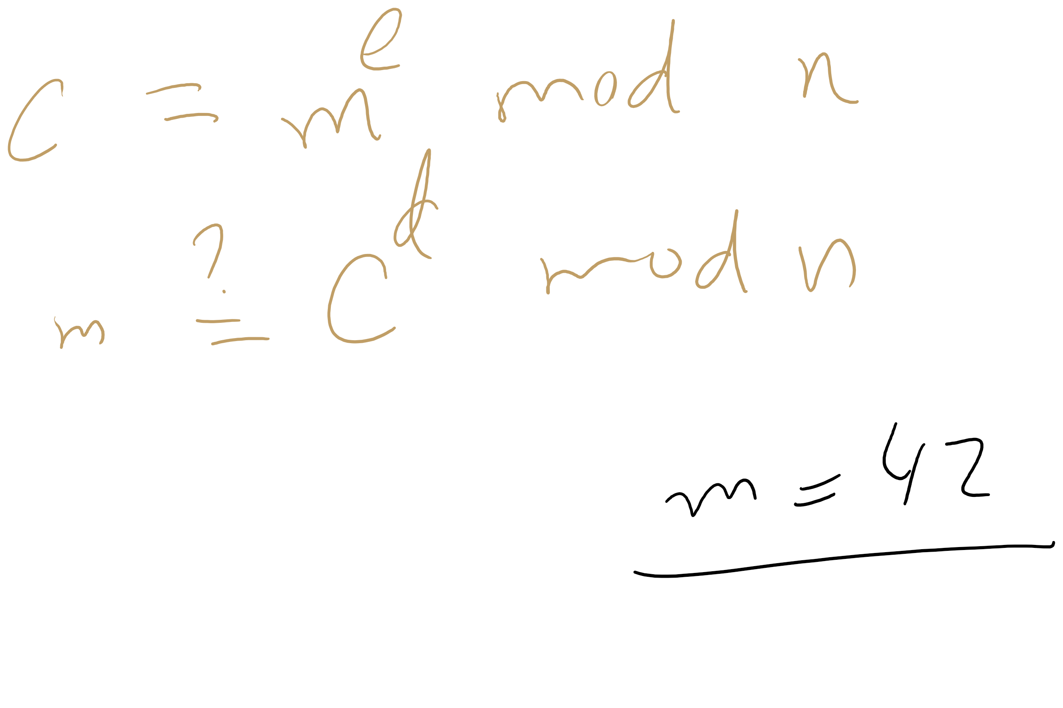
RSA Example 2

Slide 47
OK, but how does m^{ed} = m mod n?
Feel free to look up the proof using Fermat’s little theorem
Knowing this proof is NOT required for the course
Knowing how to generate RSA keys and encrypt/decrypt IS
For this course, we’ll settle with our example showing that it does work

Slide 48
Why is RSA secure?
4 avenues of attack on the math of RSA were identified in the original paper:
Factoring n to find p and q
Determining φ(n) without factoring n
Determining d without factoring n or learning φ(n)
Learning to take e^{th} roots modulo n

Slide 49
Factoring n
To the best of our knowledge, this is hard
A 768 bit RSA key was factored one time using the best currently known algorithm
Took 1500 CPU years
2 years of real time on hundreds of computers
Hence, large keys are pretty safe
2048 bit keys are a pretty good bet for now

Slide 50
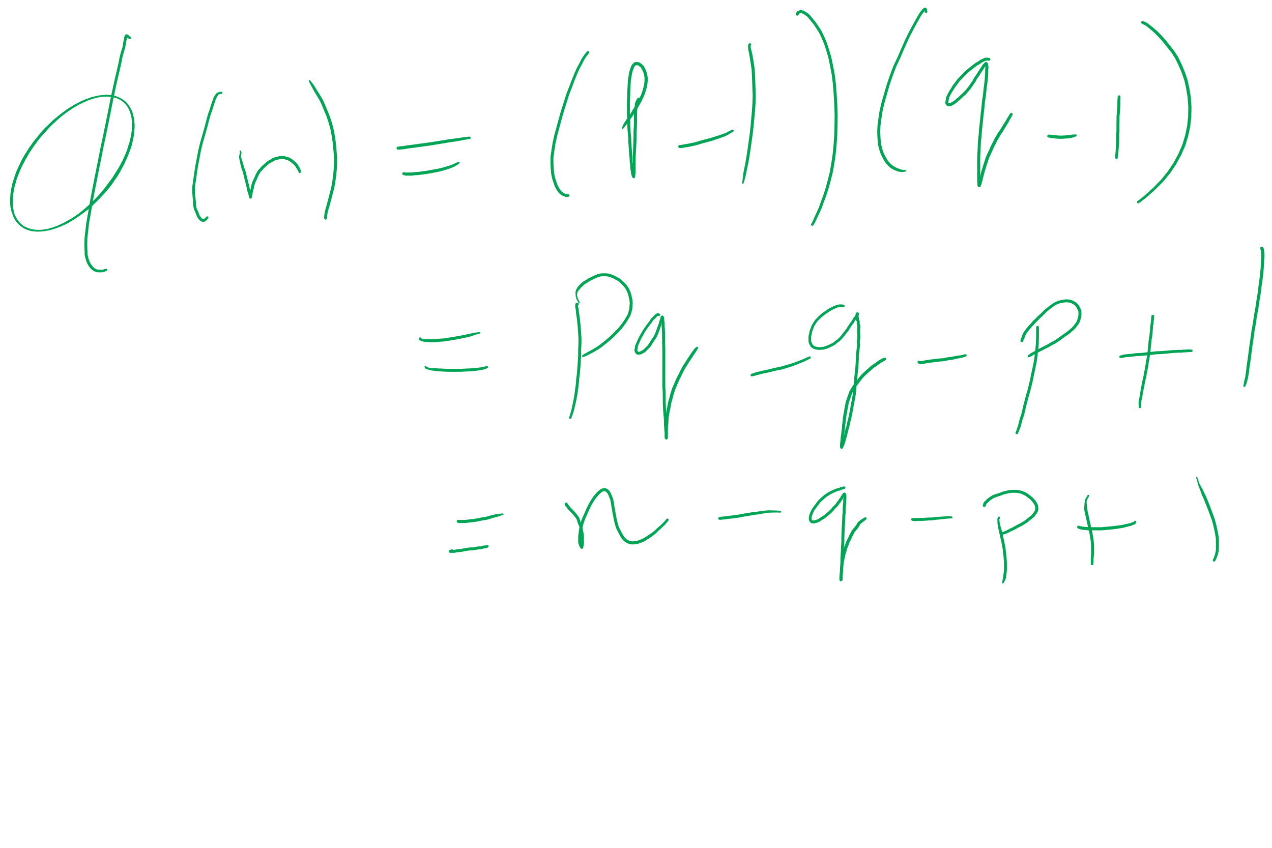
What about determining φ(n) without factoring n?
Would allow us to easily compute d because ed = 1 mod φ(n)
Note:
φ(n) = n - p - q + 1
φ(n) = n - (p + q) + 1
(p + q) = n + 1- φ(n)
(p + q) - (p - q) = 2q
Now we just need (p - q)...
(p - q)² = p² - 2pq + q²
(p - q)² = p² + 2pq + q² - 4pq
(p - q)² = (p + q)² - 4pq
(p - q)² = (p + q)² - 4n
(p - q) = √((p + q)² - 4n)
If we can figure out φ(n) efficiently, we could factor n efficiently!

Slide 51
Determining d without factoring n or learning φ(n)?
If we know, d, we can get a multiple of φ(n)
ed = 1 mod φ(n)
ed = kφ(n) + 1
For some k
ed - 1 = kφ(n)
It has been shown that n can be efficiently factored using any multiple of φ(n)
Hence, this would provide another efficient solution to factoring!

Slide 52
Learning to take e^{th} roots modulo n
Conjecture was made in 1978 that breaking RSA would yield an efficient factoring algorithm
To date, it has been not been proven or disproven

Slide 53
This all leads to the following conclusion
Odds are that breaking RSA efficiently implies that factoring can be done efficiently.
Since factoring is probably hard, RSA is probably safe to use.

Slide 54
Implementation concerns
Encryption/decryption:
How can we perform efficient exponentiations?
Key generation:
We can do multiplication, XGCD for large integers
What about finding large prime numbers?

Slide 55
Efficient exponentiation for RSA
Does this solve our problems?
ans = 1
foreach bit in y:
ans = (ans² mod n)
if bit == 1:
ans = (ans * x mod n)
ans = 1
foreach bit in y:
ans = ans²
if bit == 1:
ans = ans * x
How can we improve runtime for RSA exponentiations?
Don’t actually need x^{y}
Just need (x^{y} mod n)

